Slide 1


The Effect of Biological Sampling Effort on the Precision of Fish Biomass Estimates: An Analysis Using R and NOAA’s 2019 Acoustic Trawl Survey Data
Shannon Dolan
Notes:
Major & Minors
Going to speak about the research I did during my second internship as a Doris Duke Conservation Scholar working with NOAA, the National….

Slide 2
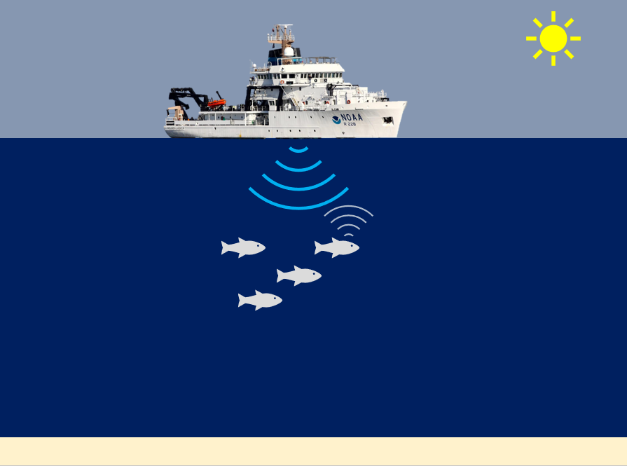
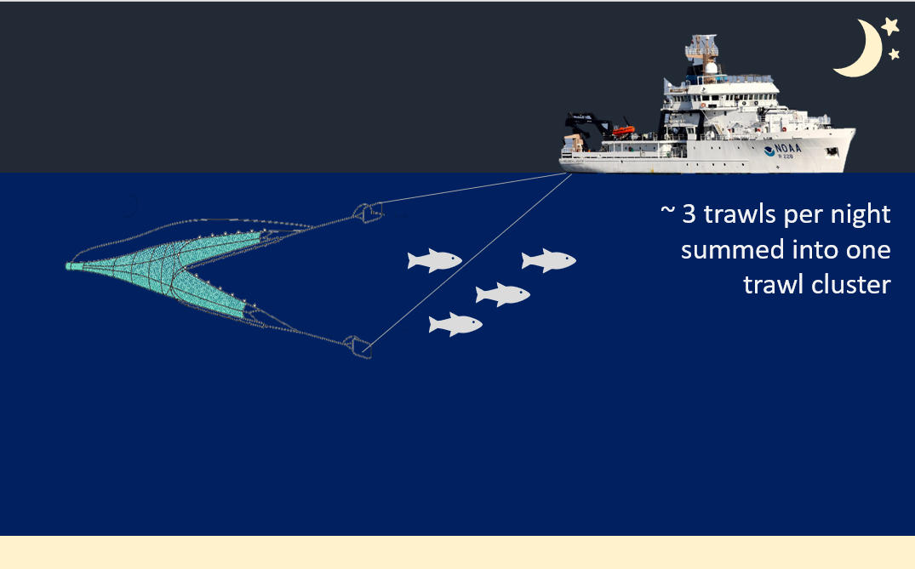
Introduction
Acoustic Trawl Survey
Daytime acoustic sampling
Nighttime trawling
Notes:
What is ATS?
Broadly, acoustic data is collected during the day and combined with the nighttime trawl data to generate species biomass estimates and stock distributions. This data is used by NOAA to inform fisheries policy.
In this case, the ATS method is used to study CPS (sardines, anchovies, herring, jack and pacific mackerel) in the CCE.
Daytime acoustic sampling involves an echosounder, which is an instrument that transmits and “hears” sound waves. If the sound waves “hits” something, such as a fish or the seafloor, an echo is bounced back and recorded by the echosounder. Now we have acoustic data that represents what we think is CPS but we don’t know specifically what species it is. Is it anchovies or sardines?
Nighttime trawling involves going to areas where we believe CPS echoes where recorded and trawling. Usually three trawls occurred in one night and were summed into trawl cluster. The proportion of species in the trawl helps us estimate how much acoustic data should be attribute to each species.
You may be asking yourself: wait why trawl at night and not as soon as you see what looks like CPS backscatter? I asked the same question.

Slide 3
Motivation & Knowledge Gap
Does trawling at night adequately represent species proportions?
Are biomass estimates and stock distributions sensitive to biological sampling effort?
Notes:
The main motivation question is does trawling at night adequately represent species proportions?
This question is difficult to answer because we would need to trawl the same location in the daytime and at night and compare the trawl catch. This would be time intensive and expensive.
The project aims to address the sub question “Are biomass estimates and stock distributions sensitive to biological sampling effort?” which helps answer if we are trawling enough to adequately represent species proportions, but doesn’t include the temporal variable yet.

Slide 4
Objective & Hypothesis
Objective: to assess the assumption that trawling effort adequately and precisely represent the true species abundance and distribution
Hypothesis: Reducing trawling effort significantly decreases the precision of coastal pelagic species biomass estimates.

Slide 5
Methods
R script
50%, 75% and 90% trawling effort
500 random samples each
Box plots, maps, and line graphs
Notes:
R script to randomly remove a varying proportion of trawl clusters and recalculate biomass estimates (and their precision) and stock distributions
The percentages are in terms of what amount of effort is being retained. For example, 75% trawling effort means I kept 75% of the trawl clusters and randomly removed 25% of the trawl clusters.

Slide 6
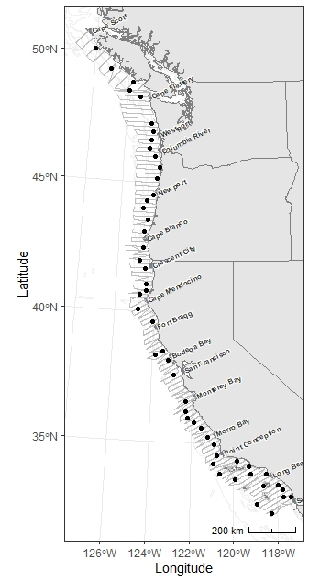
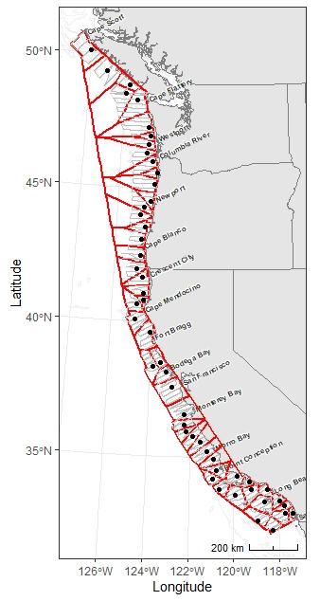
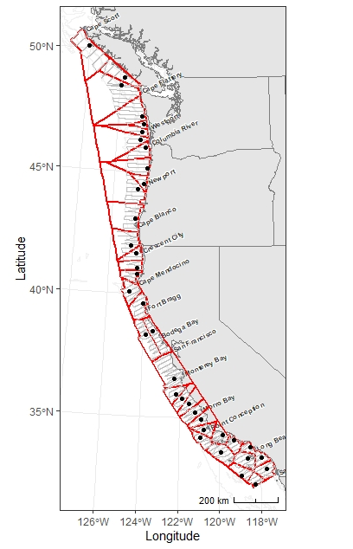
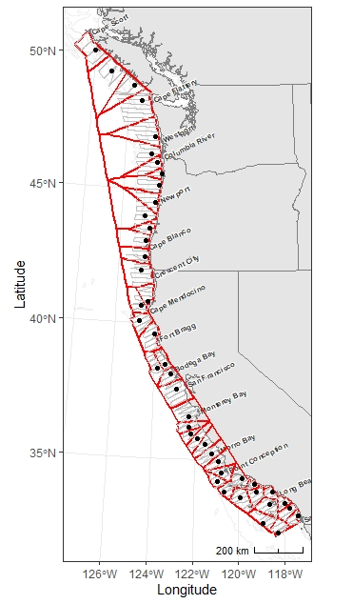
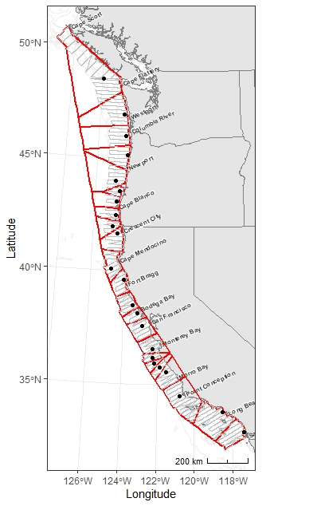
Methods
-Gray line= acoustic transects
-Black dots=trawl clusters
-Red polygons=area closest to each trawl cluster
50%
75%
90%
Notes:
To illustrate part of what the code is doing, we’re going to click through this animation.
First, this is the map of the 2019 ATS area. Gray= acoustic transects, which are split into 100 m intervals for analysis.
black dots=trawl clusters
In order to estimate biomass, the closest trawl cluster to each 100-m acoustic interval needs to be determined. One way to do that is to run a line of code that creates polygons by radially expanding out from each trawl cluster. (click) So, all the acoustic intervals shaded in red would be apportioned to that trawl cluster.
Now, let’s say we retain 90% of the trawl clusters. In this one random sample out of 500, that specific trawl cluster was removed (click) so now that original area shaded in red is split between the next two closest trawl clusters. (click) You can see how much of a difference there is in area coverage.
Same thing with 75% of trawl clusters retained.
Now with 50% of trawl clusters removed you can see how 1 remaining trawl cluster now accounts for the same area that originally 5 clusters

Slide 7
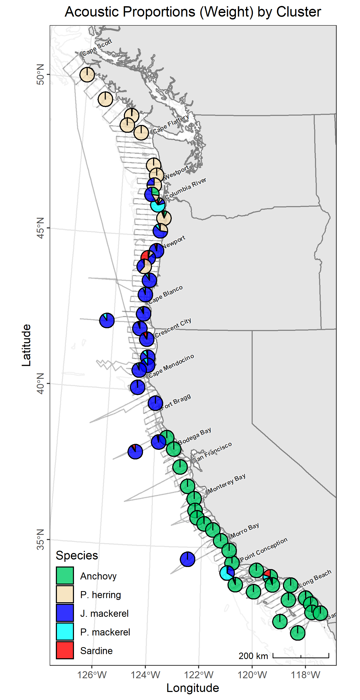
Prediction
Areas with lower species diversity in the trawl catch data will be less effected by reducing trawling effort.
Box 1
Box 2
Notes:
My prediction is that areas with lover trawl species diversity will be less effected by reducing trawl effort.
This is a map of the survey area where each pie graph represents a trawl cluster’s acoustic species proportions.
When comparing these two areas highlighted in the yellow boxes, if a trawl cluster is removed in box 2, the next nearest trawl cluster will also be majority anchovy and thus the biomass estimates won’t change much. Whereas in box 1, if a trawl cluster is removed the next closest trawl cluster has different acoustic species proportions and thus could result in a different biomass estimate.

Slide 8

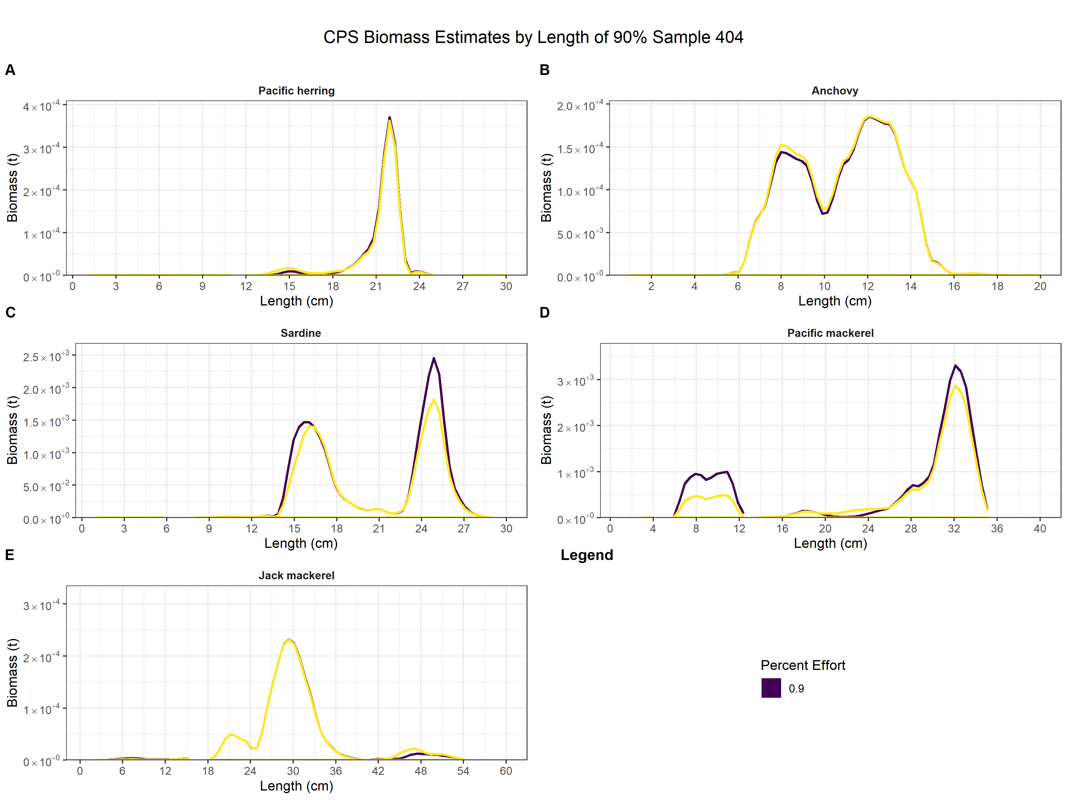
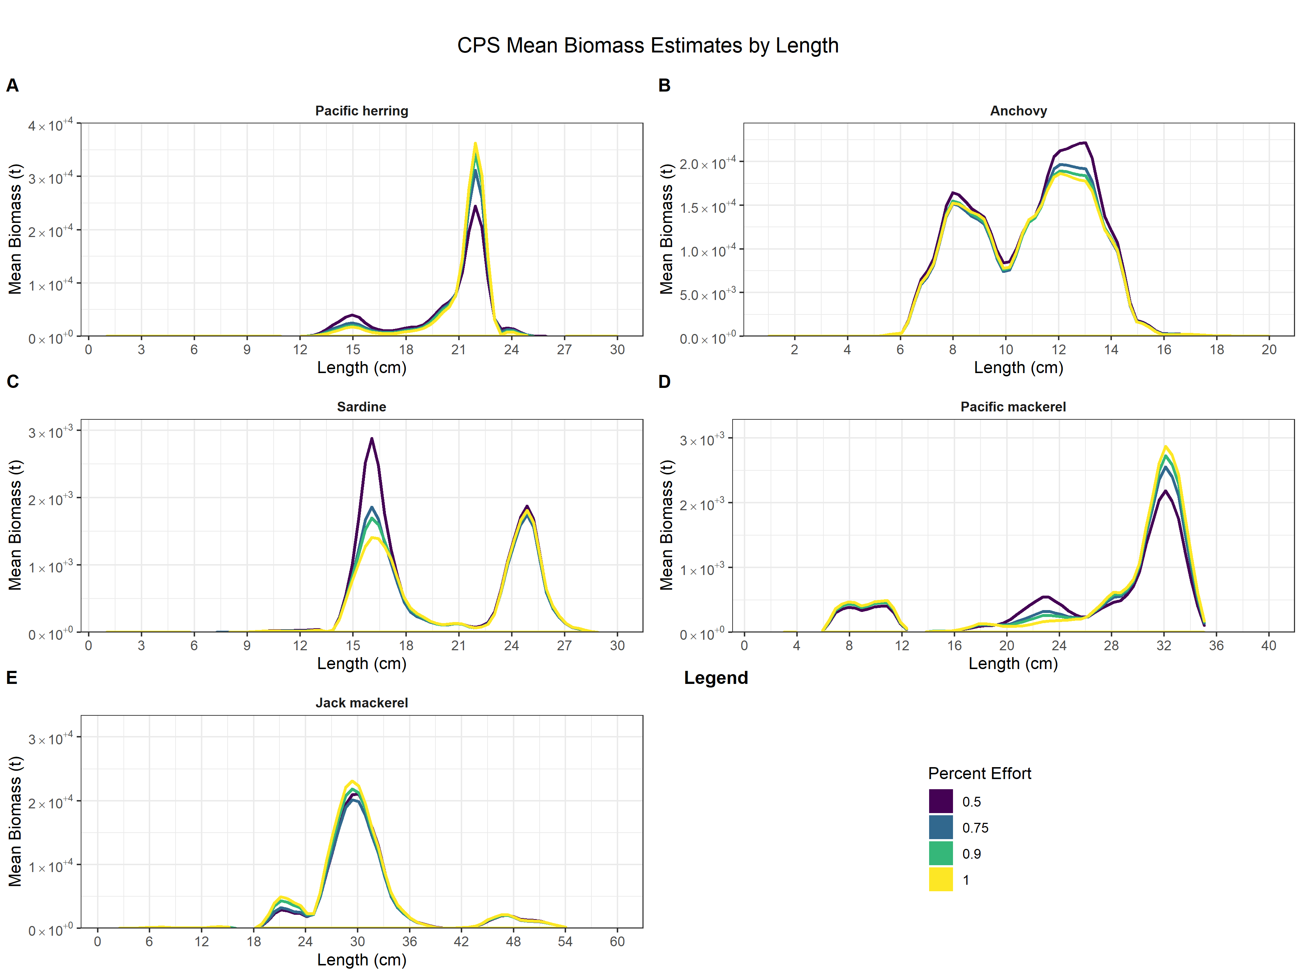
Prediction (cont.)
Notes:
So lets look at a specific example. In one random sample where 90% sampling effort was retained, 5 trawl clusters were removed (the ones with the yellow x’s on them).
The graph is sardines where biomass is on the y-axis per species length (x-axis). The yellow line is biomass estimate using all the trawl clusters and the line in purple is the random sample.
The sardine biomass estimate peak increased at lengths 24-27 cm because the trawl cluster that was removed off the coast of mid Oregon (click) was next to a trawl cluster with a higher proportion of sardines in the trawl catch. so the trawl cluster with sardines is apportioned to more transects.

Slide 9
Results
Notes:
Now we’re going to jump into overall results.

Slide 10
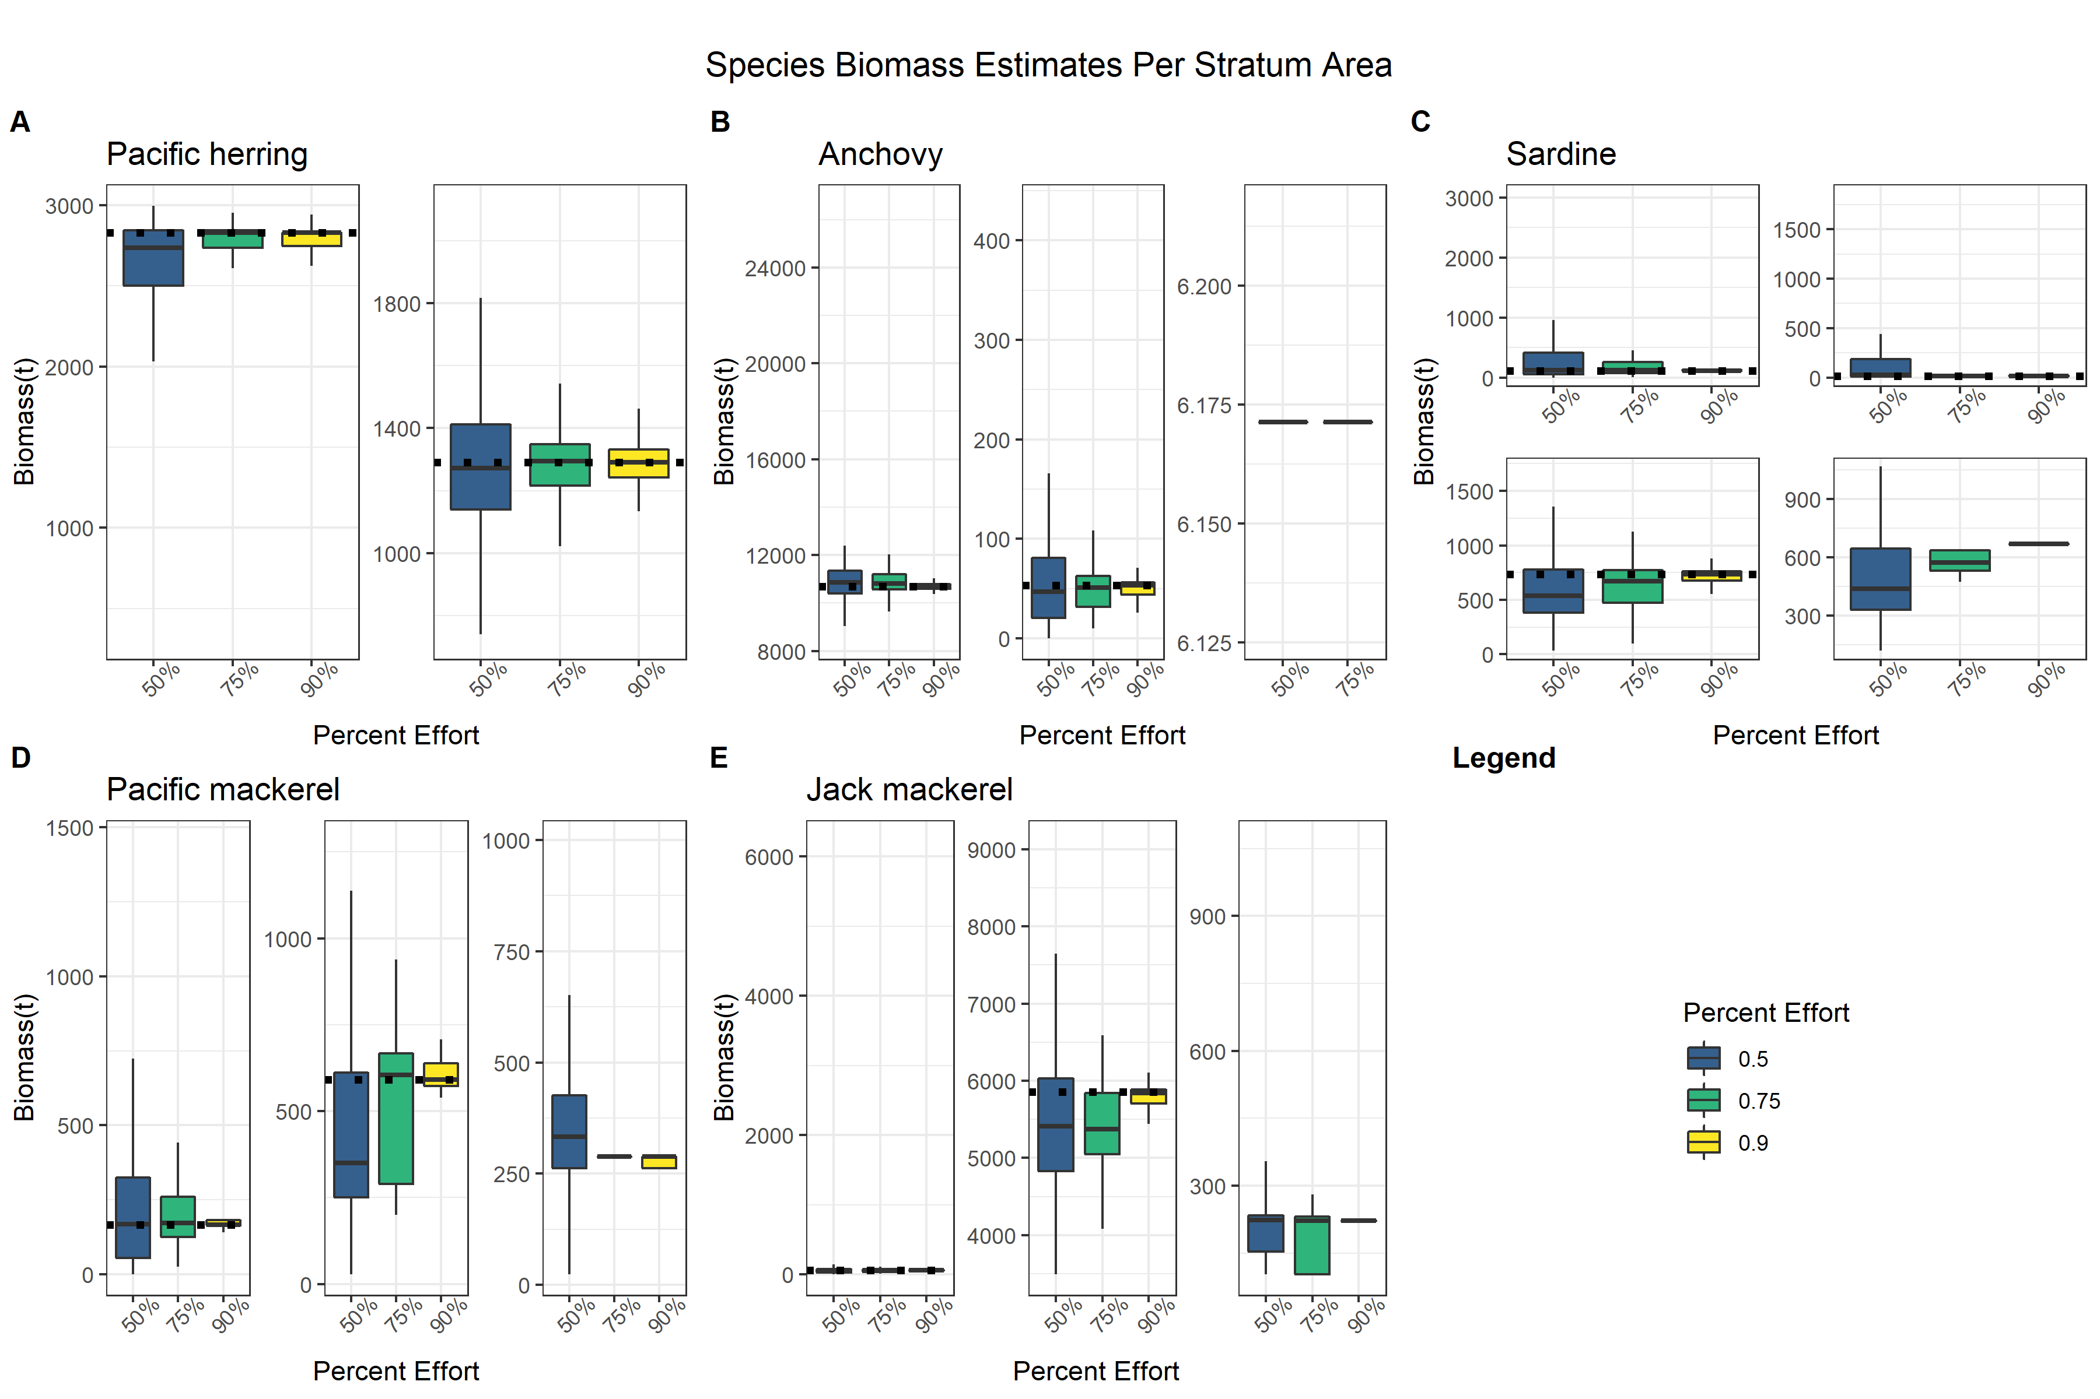
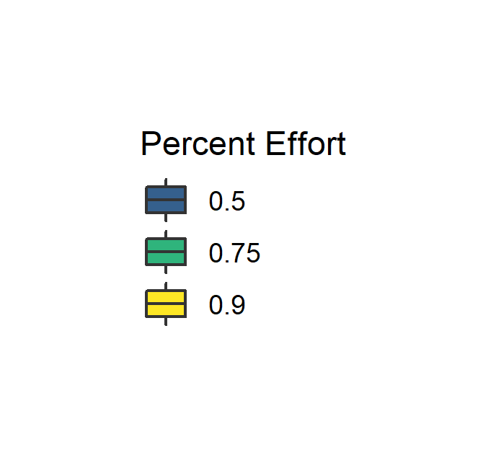
Takeaway 1: Even with increased variability, the box plot medians closely resemble the biomass estimates using all the trawls.
1
1
2
Notes:
On this slide, we have a box plot for pacific herring where the y-axis is biomass the x-axis is percent effort. The numbers in the bottom right corner are for each stratum, which are drawn around contiguous areas where acoustic data was apportioned to the species. The dashed line represents the biomass estimate using all of the trawl clusters.
Takeaway: While there might be more variability and a larger range of potential biomass estimates, the median biomass estimate at each percent effort still closely resemble the biomass estimate using all the trawl clusters.

Slide 11
Takeaway 1: The peaks occur at the same fish length.
Takeaway 2: Some fish age classes are overestimated or underestimated.
Notes:
Now we’re looking at sardines and pacific herring and the x-axis is fish length (cm) and the y-axis is mean biomass.
Each line represents a percent effort test condition where all 500 samples were averaged together to get a mean biomass at each length.
Main takeaways: (1) The peaks occur at the same fish lengths and deviation from the biomass estimate using all the trawls increases as percent effort retained decreases.
(click) (2) Some fish age classes are over or underestimated. For example, sardines length 15-18 are overestimated for 50% trawling effort which might impact fisheries policy if you believe you have a strong large recruitment class aging into the fishery.

Slide 12
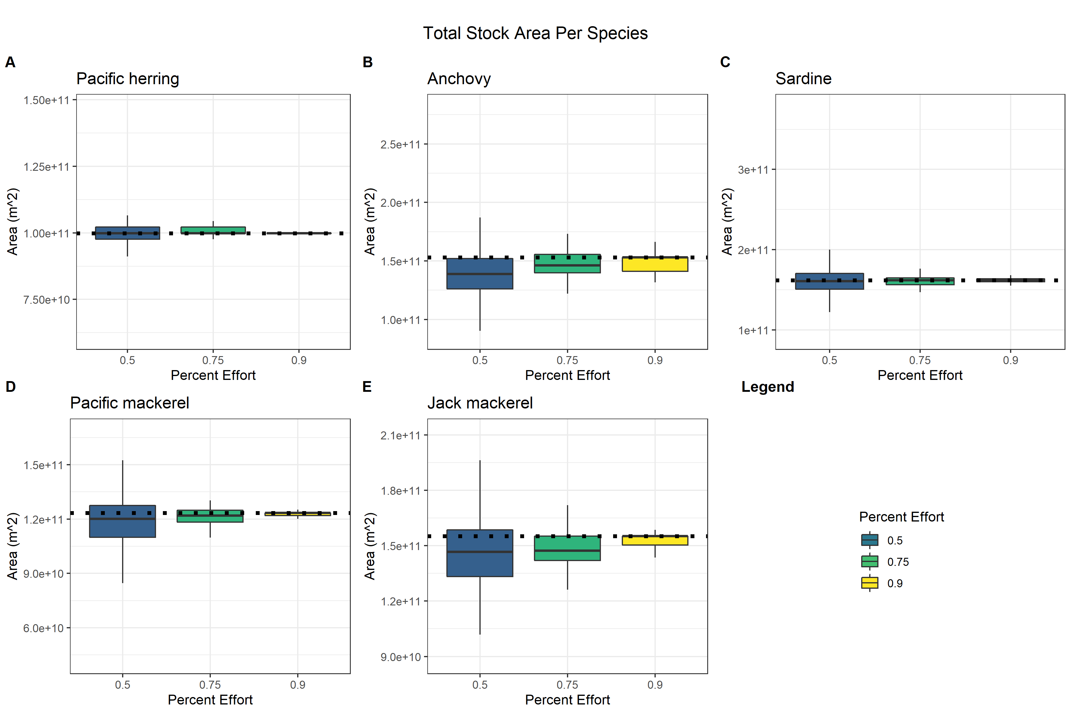
Takeaway 1: Reducing trawl effort does not result in large variation in total stratum area.
1
Notes:
Switching gears to look at area, we’re looking specifically at Jack mackerel and anchovy.
The x-axis is percent effort and the y-axis is the total stratum area for each species. The dotted line is the total stratum area estimated using all the trawl clusters.
Main takeaway here: (1) there is a relatively small change in total area, even at 50% effort retained. And as the percent effort retained decreases, the box plot median area deviates further from the total area estimated generated with all the trawl clusters.

Slide 13
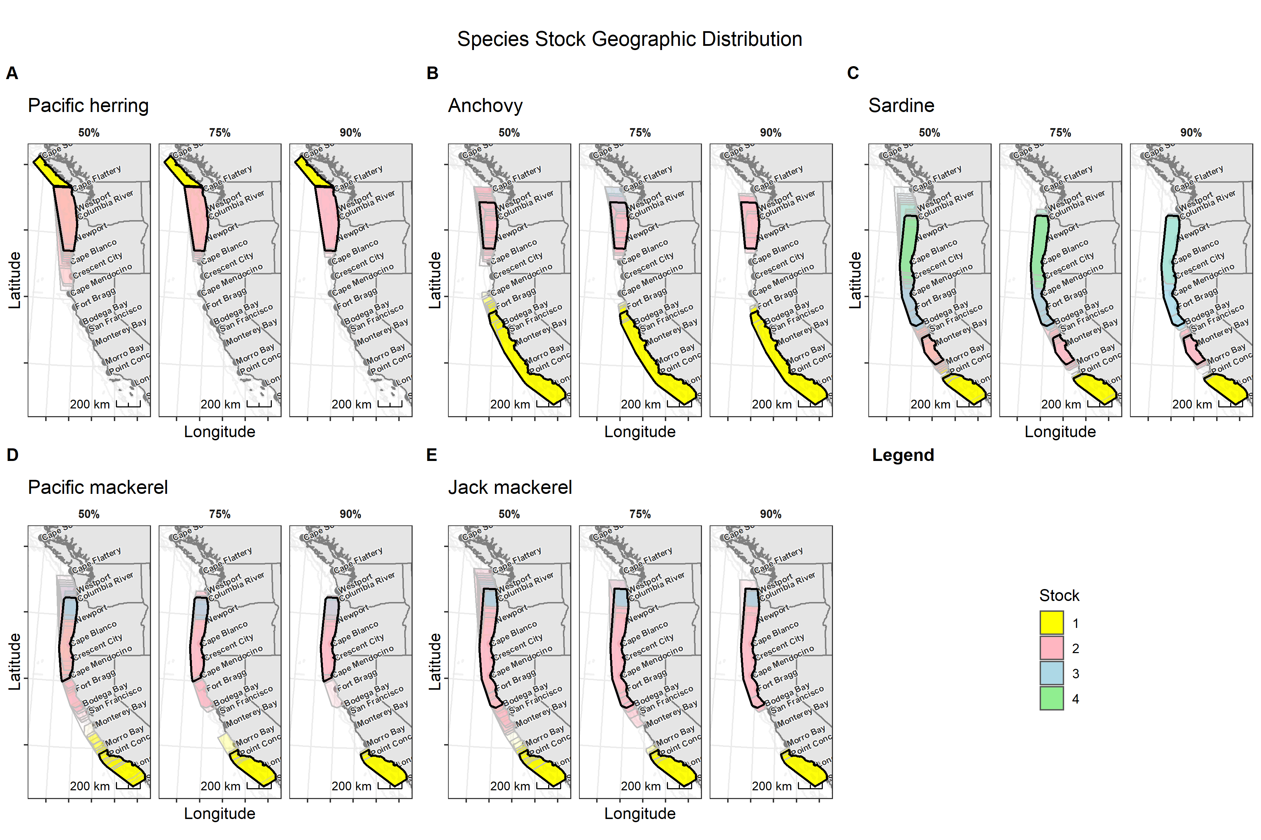
Takeaway 1: Reducing trawling effort does result in more variation of stratum geographic location.
100% Effort
Notes:
Let’s look at geographic distribution of the sardine stratum.
This is a map of the survey area where the bold black box is the stratum areas generated using all the trawl clusters and the colors represent the stratum.
The original sardine data did not include a stratum 4, but occasionally (and increasingly with a reduction in trawl effort) a fourth stratum was generated. Also, the geographic range for each stratum extends further and overlaps with other stratums at 50% trawling effort.
(click) Main takeaway: reducing trawling effort does result in more variation in stratum geographic location.

Slide 14
Discussion
Hypothesis: Reducing trawling effort significantly decreases the precision of coastal pelagic species biomass estimates.
Hypothesis is somewhat supported.
-Minimal difference in total stratum area
-Biomass estimates peaks were similar
-Context dependent
Notes:
It is context dependent: what are the acoustic species proportions of the next closest trawl?

Slide 15
Discussion
Results support current sampling effort is robust
Would not recommend trawling less
Lots of other factors at play (i.e., climate change)
Future research: trawl the same area at night and during the day
Notes:
Results support that current trawling amount is robust. The most compelling graph to support this claim is the total biomass box plot where the median biomass estimate doesn’t deviate much even with a reduction in trawling effort
Would not recommend trawling less because: in real time on the vessel, how do you determine where you might be able to trawl less? You could consider historical trends but climate change is altering our ocean systems so historical trends might not represent current conditions anymore.

Slide 16
Acknowledgements
Dr. Kevin Stierhoff
Dr. Dave Demer
Dr. Zakiya Leggett and Dr. Rena Borkhataria
Notes:
A huge thank you to my two advisors at NOAA: Dr. Stierhoff for his coding expertise and Dr. Demer for sharing some of this extensive fisheries acoustic knowledge
As well as a thank you to Dr. Legget and Dr. Rena for their support through the DDCSP

Slide 17
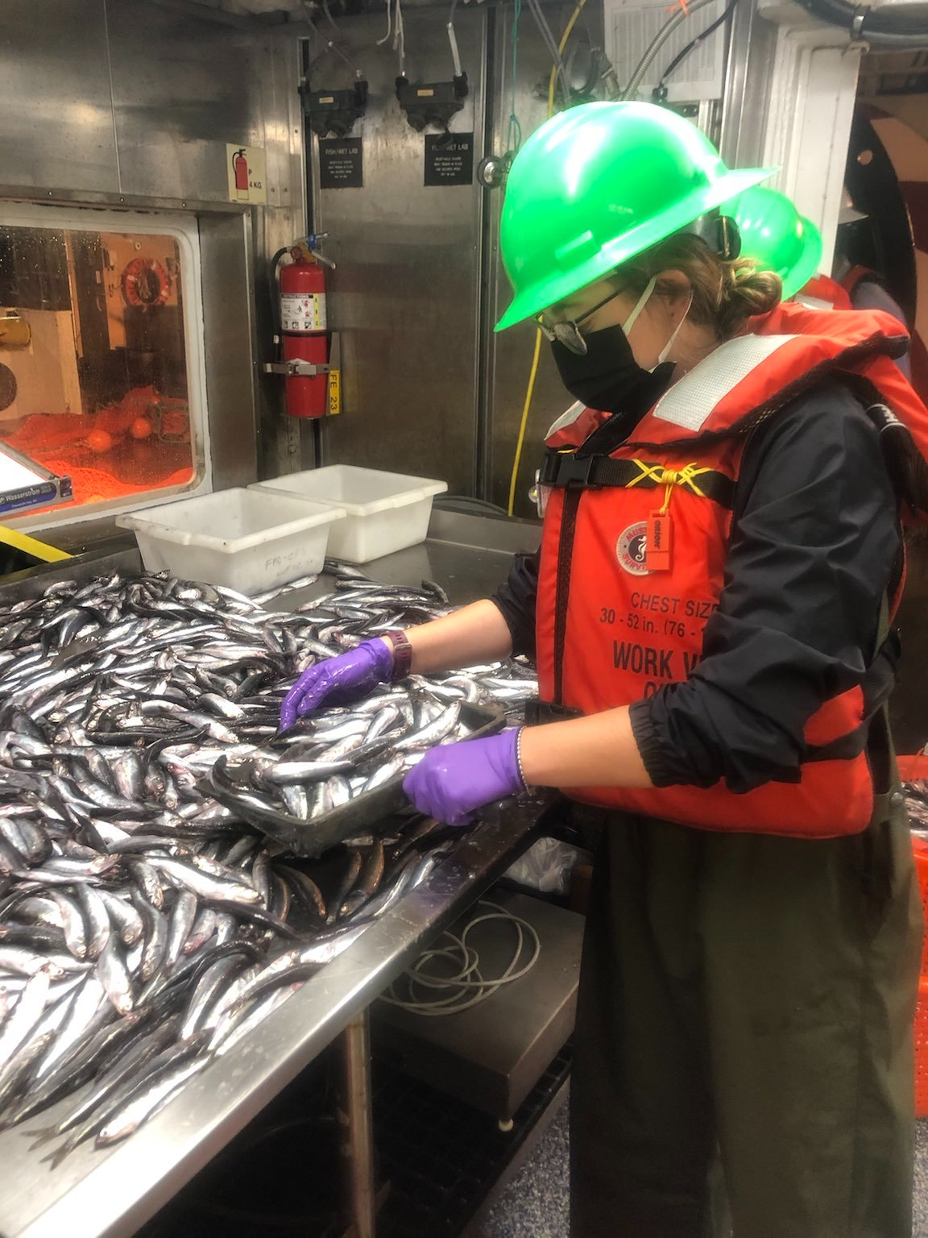
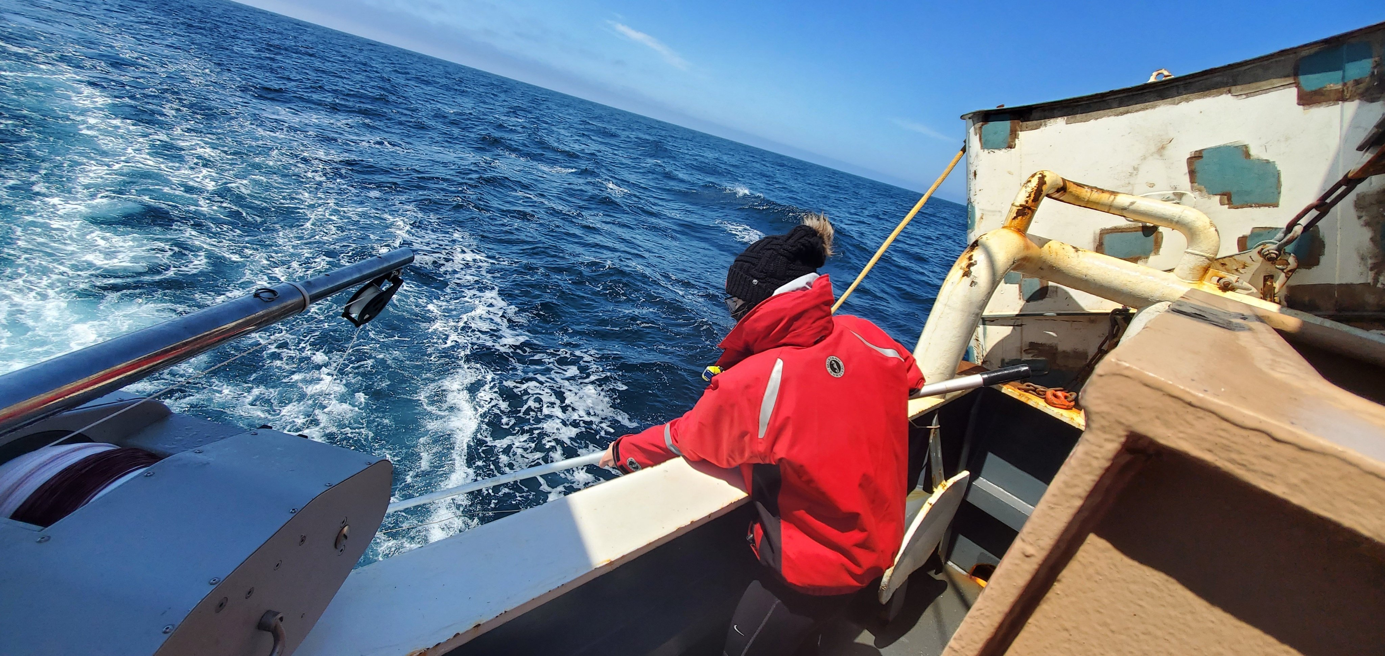
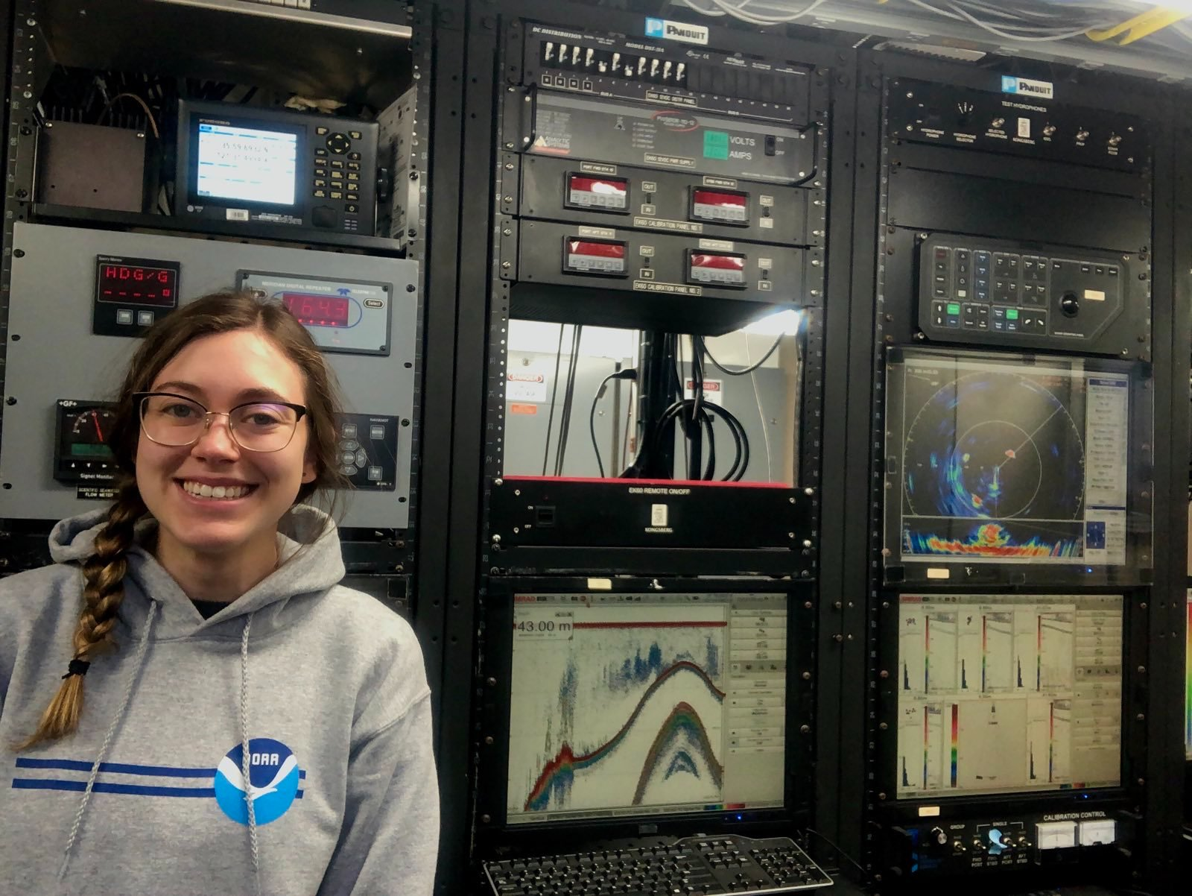
Questions?

Slide 18
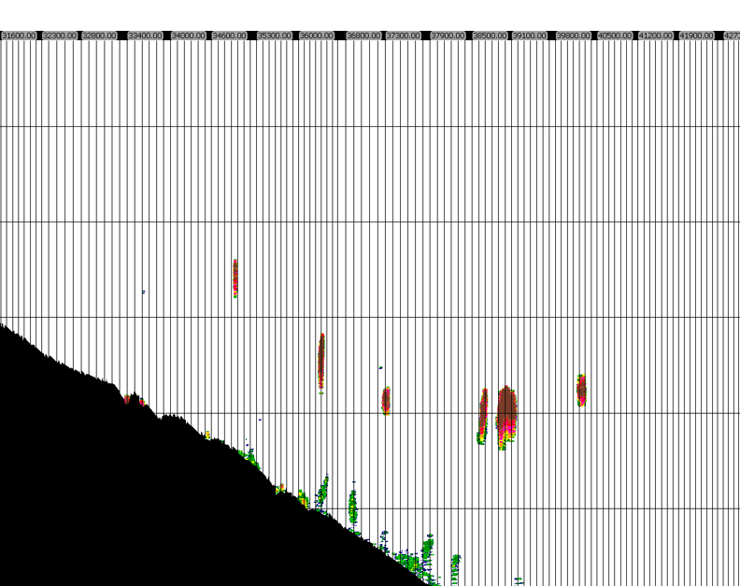
Notes:
One reason we trawl at night is that CPS can avoid the net during the day. They tend to school together (which is great to be able to detect CPS in acoustic data, but not so great to catch CPS in the trawl net). At night CPS scatter in a layer closer to the surface and have reduced visibility which makes them less able to avoid the net.

Slide 19
Stratum vs. Stock
Stratum
- Contain at least 3 acoustic transects
-Bounded by zero biomass transects
-Have no more than two consecutive zero biomass transects
Stocks
-Take stratum and assign a stock distinction based on latitude
-Stock break for anchovy is Cape Mendocino
Notes:
Stratum are boxes drawn around areas with acoustic data apportioned to a specific species. They are drawn using these rules:
Stocks

Slide 21
Methods
90%
75%
50%
Notes:
This is a side-by side comparison of one random sample from each of the three test conditions to get a sense of how with reducing trawling effort, more acoustic intervals are being attributed to each of the remaining trawl clusters.

